Slide 1
Project 3: Enhancement of Hybrid PID- Reinforcement Learning/ CNN for Puma 560 Robot Arm
April 2026

Slide 2
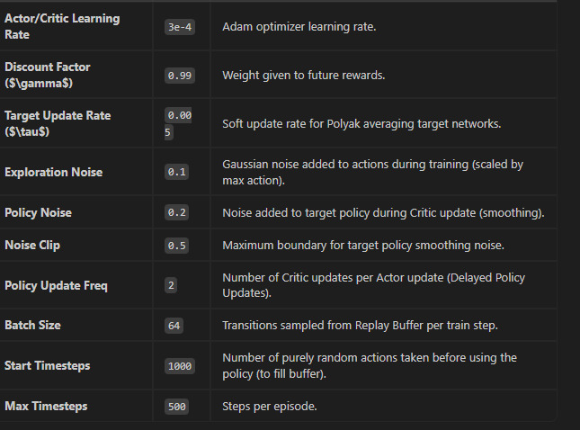
3 June 2026 Dave

Slide 3
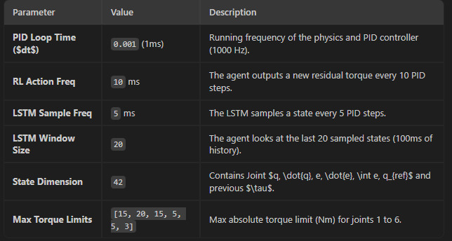

Slide 4
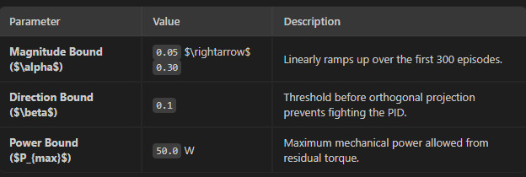

Slide 5
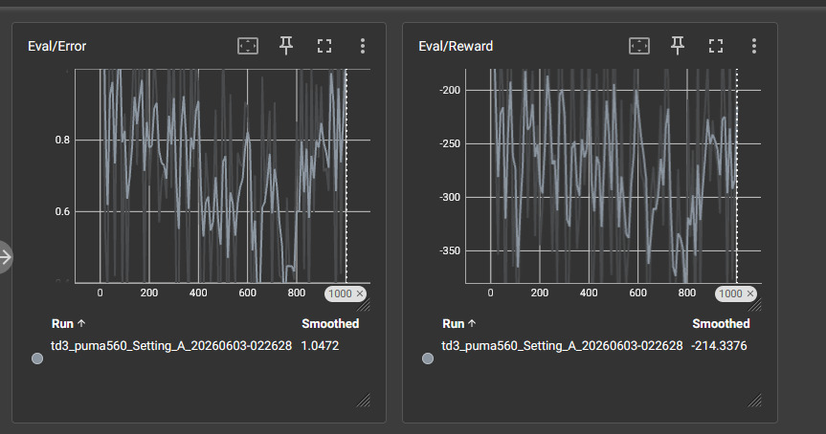
3 Jun 2026-Dave

Slide 6
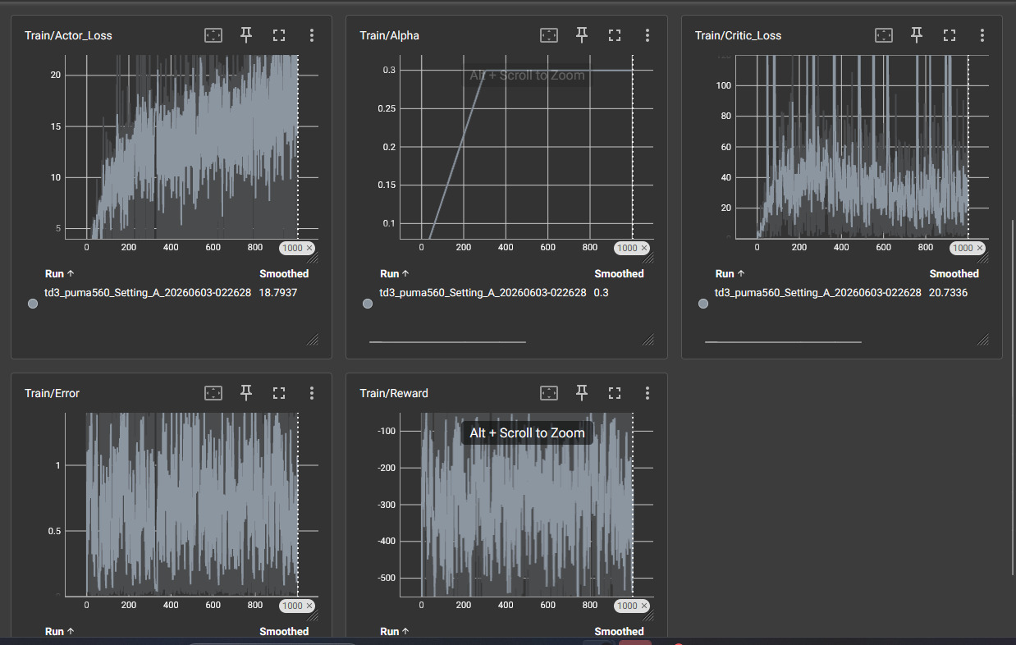

Slide 7
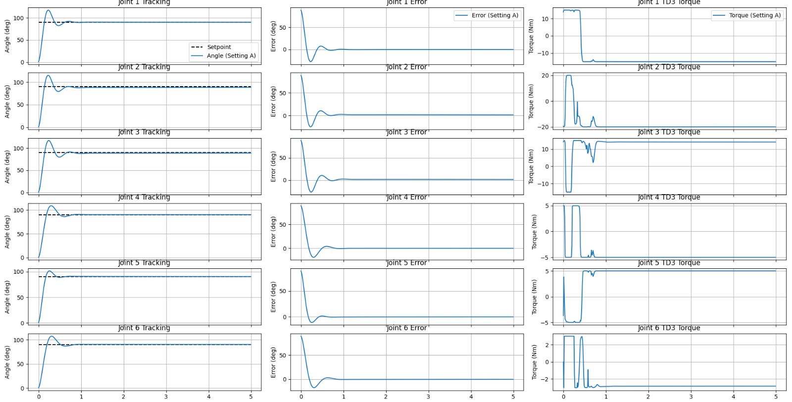
Dave, 3 June 2026

Slide 8



Standard Terms to Use (correction)
PID Control Sampling Period (not PID loop time)
LSTM Sampling Period (not Sampling Frequency)
RL Action Sampling Period (not Sampling Frequency)
Max torque limits --> Reference?
Power Bound --> Reference?
“Setpoint” diubah menjadi “Desired Trajectory”
“Angle (Setting A)”, diubah menjadi “Output”
“Setting A”, diubah menjadi “Controller Gain Setting A” dan diletakan pada baris baru

Slide 9
Manuscripts (IEEE Access)
Abstract (0%)
Introduction (v)
Literature Study → Pak Denis
Method Development (v)
Experimental Setup, Results and Analysis (10%)
Graphics
Analysis and Interpretation
Conclusion (0%)
References → Pak Denis

Slide 10
9 Jun 2026
Experimental Setup, Results and Analysis:
Learning vs Control system performance.
Effect of sampling time
Ablation study
Mean Squared Error algorithm and code
Integral Squared Error algorithm and code.
Rise Time algorithm and code
Steady State Error algorithm and code
Stages:
1. Substance all completely presented in the manuscript (tables, graphics, anlysis) by 30 June 2026; 2. Lay-outing; 3. Proofreading; 4. Submission 7 July 2026

Slide 11
PID Gain Setting A Reference Paper:
Link 1:
Mass1
Length1
Controller 1
KP1:
KI1:
KD1:
Motor 1
Resistance:
Inductance:
Mass:
Friction Coefficient:
Etc
Link 6:
Mass1
Length1
Controller 6
KP6:
KI6:
KD6:
Motor 6
Resistance:
Inductance:
Mass:
Friction Coefficient:
Etc

Slide 12
PID Gain Setting B Reference Paper:
Link 1:
Mass1
Length1
Controller 1
KP1:
KI1:
KD1:
Motor 1
Resistance:
Inductance:
Mass:
Friction Coefficient:
Etc
Link 6:
Mass1
Length1
Controller 6
KP6:
KI6:
KD6:
Motor 6
Resistance:
Inductance:
Mass:
Friction Coefficient:
Etc

Slide 13
PID Gain Setting A
Experiment A1
Parameter values:
PID sampling time: ….. ms
Conventional PID
Control System Response Graphs
Position
Velocity
Error

Slide 14
PID Gain Setting A
Experiment A2
Parameter values:
LSTM:
Lyapunov Safety Cage:
PID Safety sampling time: …. ms
LSTM sampling time: …. ms
RL sampling time:…. ms
PID with Residual Torque
Learning Result Graphs
Control System Response Graphs
Position
Velocity
Error

Slide 15
Ablation Study: PID Gain Setting A with No Safety Cage
Experiment A3
Parameter values:
LSTM:
Lyapunov Safety Cage:
PID Safety sampling time: …. ms
LSTM sampling time: …. ms
RL sampling time:…. ms
PID with Residual Torque
Learning Result Graphs
Control System Response Graphs
Position
Velocity
Error

Slide 16
PID Gain Setting A: Effect of Sampling Time Variation
Experiment A4
Sampling Time Controller
Sampling LSTM
Sampling Reinforcement Learning

Slide 17
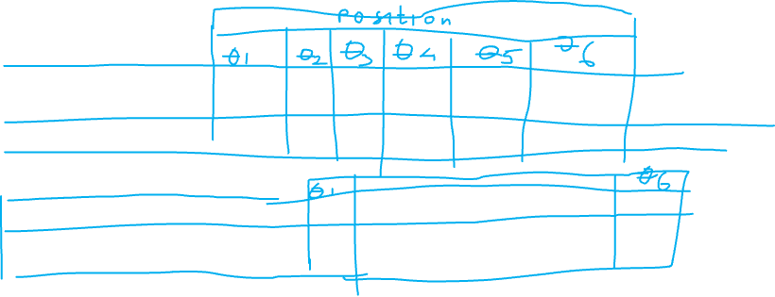
Create Tables for PID Gain Setting A
Performance Metric values are put in the corresponding tables
Step Input:
Rise Time
Steady State Error
Overshoot
Tracking performance:
Mean Squared Error values
Integral Squared Error values

Slide 18
PID Gain Setting B
Experiment B1
Parameter values:
PID sampling time: ….. ms
Conventional PID
Control System Response Graphs
Position
Velocity
Error

Slide 19
PID Gain Setting B
Experiment B2
Parameter values:
LSTM:
Lyapunov Safety Cage:
PID Safety sampling time: …. ms
LSTM sampling time: …. ms
RL sampling time:…. ms
PID with Residual Torque
Learning Result Graphs
Control System Response Graphs
Position
Velocity
Error

Slide 20
Ablation Study: PID Gain Setting B with No Safety Cage
Experiment B3
Parameter values:
LSTM:
Lyapunov Safety Cage:
PID Safety sampling time: …. ms
LSTM sampling time: …. ms
RL sampling time:…. ms
PID with Residual Torque
Learning Result Graphs
Control System Response Graphs
Position
Velocity
Error

Slide 21
PID Gain Setting B: Effect of Sampling Time Variation
Experiment b4
Sampling Time Controller
Sampling LSTM
Sampling Reinforcement Learning

Slide 22
Create Tables for PID Gain Setting B
Performance Metric values are put in the corresponding tables
Step Input:
Rise Time
Steady State Error
Overshoot
Tracking performance:
Mean Squared Error values
Integral Squared Error values

Slide 23
